Slide 1

RC Short Course: AlphaFold 3 on Alpine

Slide 2


AlphaFold 3 on Alpine
Date: October 7, 2025
Instructor: Mohal Khandelwal
Website: www.rc.colorado.edu/rc
Documentation: https://curc.readthedocs.io
Helpdesk: rc-help@colorado.edu
Survey: http://tinyurl.com/curc-survey18
Slides
https://github.com/ResearchComputing/alphafold3_short_course

Slide 3
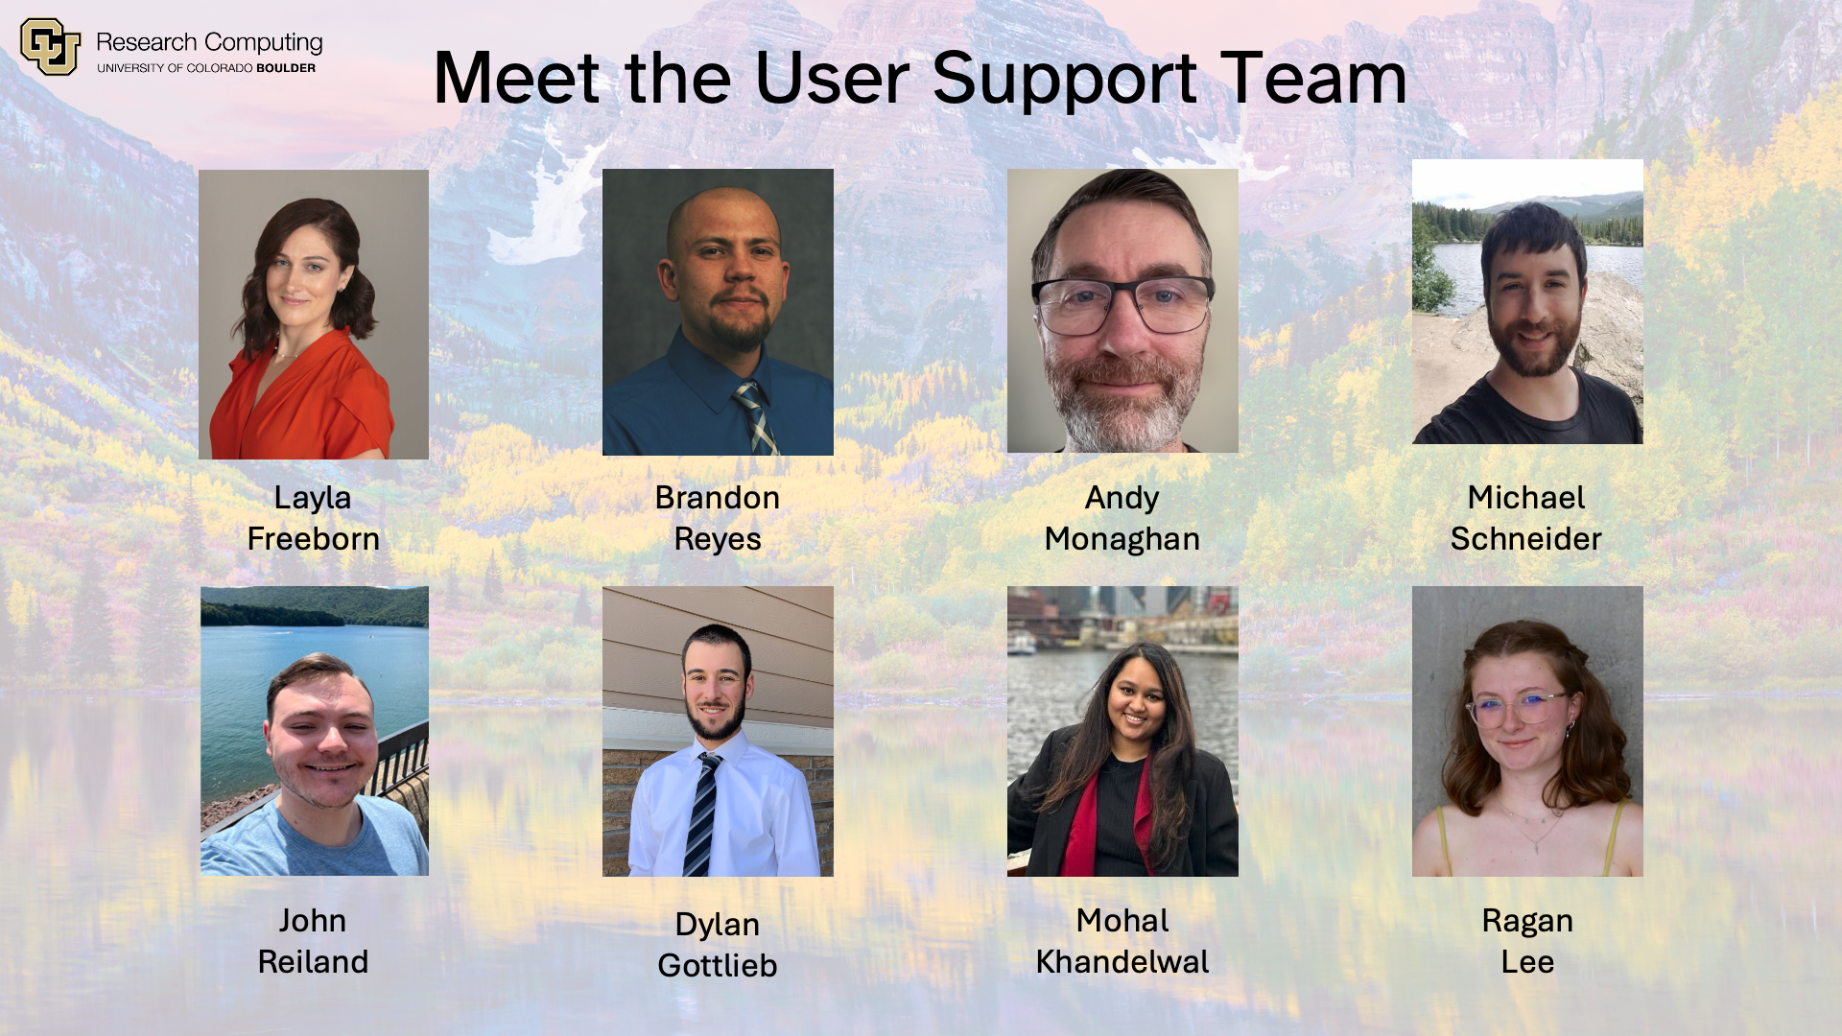

Slide 4
Background: The Protein Folding Problem
What a protein does (it’s biological function) depends on its 3D structure
Figuring out the what shapes a protein folds into has been a grand challenge in biology for 50+ years
Can we predict a protein’s 3D structure based on its 1D aa sequence?

Slide 5
Notable changes to AlphaFold 3
The model parameters are a separate download with licensing issues.
The main run_alphafold.py script can now be executed in 2 phases, the CPU/time intensive database search, followed by the GPU-based model inference.
The database has shrunk from 2+ TB to ~600 GB.
The input file format has changed to a custom JSON format, instead of FASTA file.
Overall performance appears to be improved, qualitatively.

Slide 6







AlphaFold 3 Installation
No customization of the Python code
The wrapper:
Chooses the number of copies of jackhmmer/nhmmer processes to run in parallel based on the number of cores assigned to the job.
These are hard-coded to run with 8 threads each.
Database: ~210 GB file. Pre-installed and accessible via AF3_DATABASES_DIR
Containerized module
Built from Docker image
run_alphafold.sh
Wrapper script that handles all inputs to run_alphafold.py in the container
Notes:
No customization of the Python code,
The wrapper is more complicated:
Selects the “flash attention” parameter based on the compute capability of the GPU.
Chooses the number of copies of jackhmmer/nhmmer processes to run in parallel based on the number of cores assigned to the job.
Not totally straightforward as these are hard-coded to run with 8 threads each. See here, lines 231-232.

Slide 7
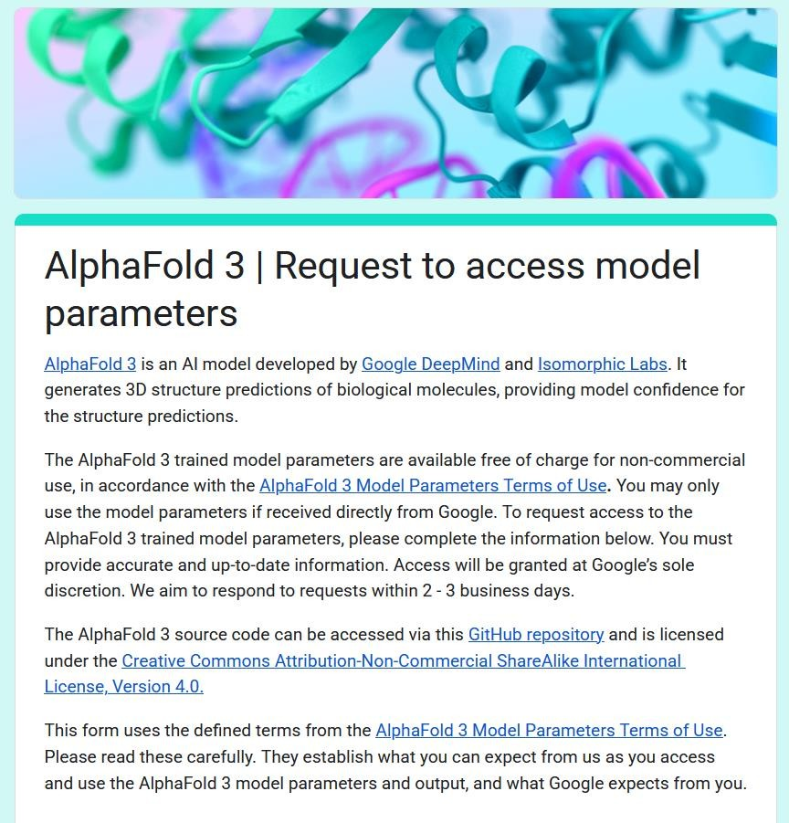
Model Parameters
We opted to have users download their own copy of the model parameters.
We provide a page with links and guidance on submitting the Google form to request their own copy.
So far, no user has reported an issue obtaining their own copy following the guidance here.

Slide 8
AlphaFold 3 Inputs
The input JSON file format is the biggest change for users.
Documentation on the format is available.
There aren’t very many examples online.
DeepMind does not provide any sort of validation tool for the format.
Error messages for bad inputs are not terribly helpful.
You can provide inputs in one of two ways:
Single input file: --json_path flag followed by the path to a single JSON file.
Multiple input files: --input_dir flag followed by the path to a directory of JSON files.

Slide 9
AlphaFold 3 Module
Loading the module (ml alphafold/3.0.0):
creates a shortcut to the AlphaFold 3 script
sets environment variables used by the wrapper script:
AF3_IMAGE: Path to the AlphaFold 3 container image
AF3_CODE_DIR: Directory containing the AlphaFold 3 codebase
AF3_DATABASES_DIR: Location of the required AlphaFold 3 reference databases
redirects temporary files to /scratch/alpine/$USER
Can be overridden by resetting TMPDIR after you load the module:

Slide 10
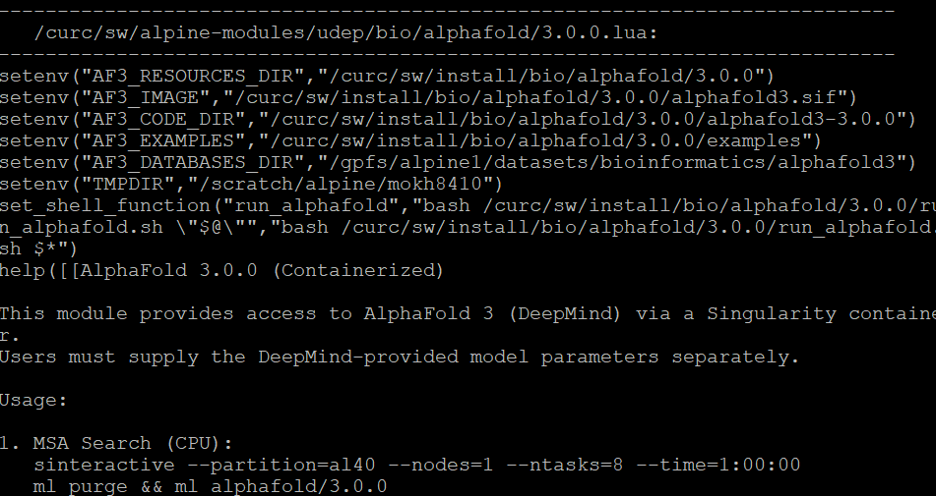
AlphaFold 3 Module

Slide 11
AlphaFold 3 Workflow
AlphaFold 3 runs in two stages:
Stage 1 (MSA Search): CPU and I/O-intensive; uses jackhmmer and hhmsearch.
Stage 2 (Inference): GPU-intensive; performs structure prediction.
To better utilize limited GPU resources, these stages can be split using flags:
--norun_inference → Run only the MSA/data pipeline (Stage 1)
--norun_data_pipeline → Run only the inference step (Stage 2)

Slide 12
Running Your Prediction
Example input files and scripts are in /curc/sw/install/bio/alphafold/3.0.0/examples.
Loading the module stores this path in AF3_EXAMPLES.
Copy the folder to a location where you have write permissions
$ls $AF3_EXAMPLES
alphafold3_alpine_cpu.sh alphafold3_alpine_gpu.sh alphafold3_alpine.sh fold_protein_2PV7

Slide 13
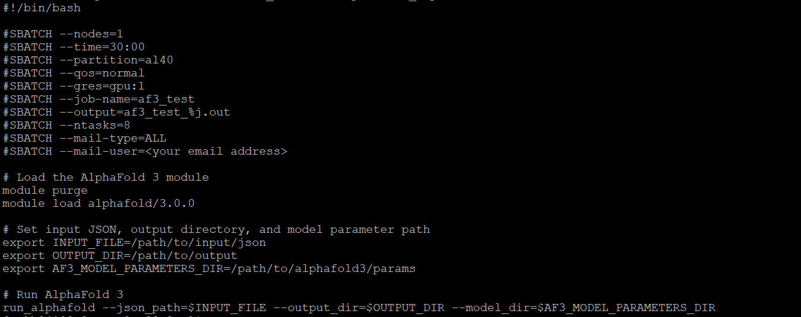
Running Your Prediction

Slide 14
Visualizing Outputs
AlphaPickle: https://github.com/mattarnoldbio/alphapickle
PyMol (free for education): https://pymol.org/
AlphaFold Protein Structure Database website provides a great resource for learning how to interpret visualizations: https://alphafold.ebi.ac.uk/entry/Q9Y223#help

Slide 15

Thank you!
http://tinyurl.com/curc-survey18
Survey and feedback
10/1/2025

